Slide 1
Project Plan
Creating a website to showcase a photographer's work

Slide 2
Key Stakeholders
Internal
Project Sponsor
Product Owner
Project Manager
Business Analyst
Software Engineer
Test Engineer
External
Customer

Slide 3
Stakeholders Responsibilities
Project Sponsor
Secures approval for the project
Helps to define clear project goals
Provides resources (funding, Personnel etc)
Ensures the project aligns with organizational objectives
Business Analyst
Requirements gathering
Process Analysis and Improvement
Facilitating meetings
Software Engineer
Design
Coding
Debugging
Collaborating
Product Owner
Prioritisation
Managing the product backlog
Hosts meetings
Customer
Provide project requirements
Feedback
Project Manager
Outlines project scope, objectives etc
Assigns roles and responsibilities
Ensure project stays within budget and on track
Communicate project progress to stakeholders
Test Engineer
Test planning
Test execution
Defect Identification

Slide 4
Stakeholder Management Plan
Project Manager
Business Analyst
High
Software Engineer
Project Sponsor
Project Manager
Product Owner
Test Engineer
Business Analyst
Customer
Level of Influence
Software Engineer
Test Engineer
Customer
Low
Low
Level of Interest
High

Slide 5
Requirements Gathering Using a Focus-Group
Process
Focus Group Session
Clearly outline the goals and objectives of the focus group, such as understanding the target audience
Select a diverse group of people who represent the website's potential users
Plan the session: present the website concept including specific features and functionalities.
Conduct the focus group session and encourage feedback from the participants about the desired content, layout etc
Document the findings: Take notes during the session to capture the participants feedback
A group gathered at the local village hall to discuss the creation of a website showcasing the photography work of a local artist, Kent Adams. The group was made up of aspiring photographers, and some of Kent’s longtime supporters.
The facilitator, a friendly young web designer named Steve, started the discussion by introducing Kent’s work through a series of photographs displayed around the room. The participants expressed their admiration for Kent’s ability to capture the beauty of the villages landscapes. The participants voiced their preference for a website that would reflect simplicity . They emphasized the importance of an easy to navigate website that would allow visitors to immerse themselves in Kent’s photographs.
The group agreed on showcasing Kent's photographs in a gallery format. They also highlighted the importance of including text that would describe each photograph.
In terms of design, the participants favoured soft colours and a way to easily navigate the different areas of the website and to have a way of commenting or providing feedback.

Slide 6
MoSCoW
Mo
S
Co
W
A visually appealing design
An easy to navigate interface
High-quality images
A well organised portfolio
A dynamic gallery: full-screen mode, slideshow or grid view
A bio about who the photographer is and their story
Different genres
Fast loading times for images
The ability to sort photographs by type
A way to provide feedback to the photographer
An online store in which to purchase the photographers work
Complex navigation
Low-quality images
Excessive text descriptions
Distracting elements such as flashy graphics which could divert the viewers attention from the photographer’s work

Slide 7
Requirements
Functional Requirements
Non-Functional Requirements
Usability
Users must be able to navigate the website and portfolio easily
Users must be able to click an image to view it in full size and more detail
Organisation
Images should be organised clearly into different genres to assist users in finding photographs specific to the category they are looking for
Sorting
Users should be able to sort photographs by type e.g. mountains, waterfalls, nature
Feedback
Users should be able to provide feedback to the photographer via a form or by email
Performance
The website should load quickly and efficiently, with minimal loading times for high-resolution images and be able to handle large volumes of visitors
Security
The website should have robust security measures to protect the photographer's intellectual property and prevent unauthorized use of images and should ensure the privacy and confidentiality of any user data collected through contact forms or feedback mechanisms.
Scalability
The website should be designed to accommodate future growth, allowing for the addition of new images and features. It should be capable of handling increased traffic and content without impacting performance
Reliability
The website should be reliable and consistently available, with minimal downtime or disruptions to ensure that visitors can access the photographer's work at any time. It should have robust backup and recovery mechanisms to prevent data loss and ensure the photographer's portfolio is preserved.

Slide 8
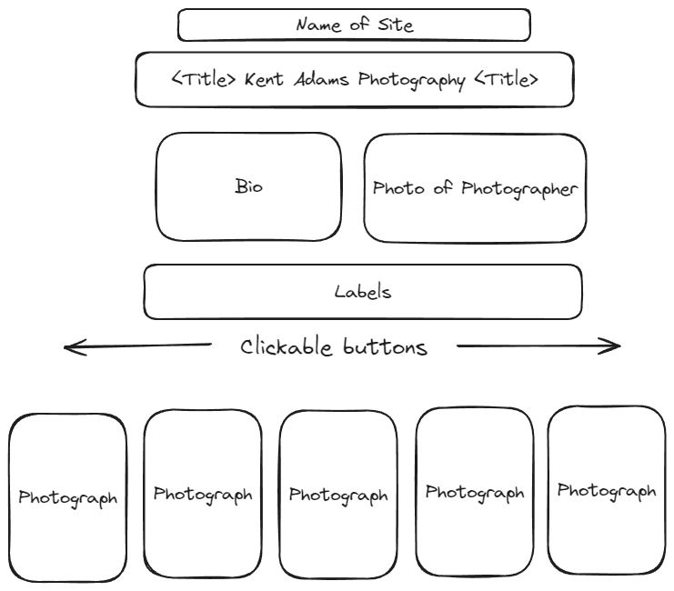
User Interface

Slide 9
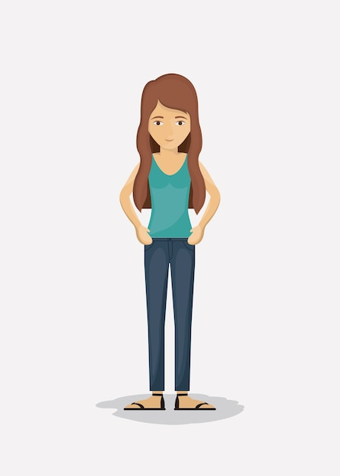
User Journey
Initial Discovery
Browsing the portfolio
Exploring Individual Images
Purchase options
User discovers and navigates to the website through a direct link on the photographers Instagram site
User clicks on a genre and is taken to a gallery
The user clicks on an image to view it in detail. The user can easily navigate to the next or previous image in the gallery
The user explores the possibility of purchasing a print by visiting the store section
End User

Slide 10
Dependencies
Software Dependencies
Web Development Frameworks
Front-end frameworks like React for building interactive user interfaces and dynamic web pages.
Back-end frameworks like Node.js for handling server-side logic, data management, and integration with databases
Web Development Tools
HTML, CSS, and JavaScript for creating the structure, style, and interactivity of the website's pages.
Text editors or integrated development environments (IDEs) like Visual Studio Code
Image Editing Software:
Graphics editing tools like Adobe Photoshop, Lightroom, or GIMP for enhancing, retouching, and optimizing images before uploading them to the website.
Image optimization plugins or tools that are designed for showcasing high-quality images and help to compress and resize images without compromising on quality
Web Hosting Services
Hosting plans that support the storage and seamless delivery of high-resolution images to visitors without compromising website performance
Responsive Design Frameworks
Frameworks that offer responsive grid systems and components to ensure that the photographer's portfolio is accessible and visually appealing on various devices
Hardware Dependencies
Computer System
High-resolution displays that allow for accurate visual representation and editing of images, ensuring the quality and aesthetics of the photographer's portfolio.
External Storage Devices
Cloud storage solutions that provide secure and accessible storage for website data, ensuring data redundancy and protection against data loss or hardware failures.
Peripherals and Accessories
High-resolution scanners or digital image scanners for converting physical photographs, negatives, or slides into digital formats suitable for online showcasing and archiving.
Backup Solutions
Uninterruptible Power Supply (UPS) systems or surge protectors to safeguard the computer system and networking equipment from unexpected power outages or voltage fluctuations, preventing data loss and hardware damage.
Automatic backup solutions or external backup drives to create regular backups of the website's content, databases, and related files, enabling quick data recovery in the event of hardware failures or data corruption.

Slide 11
Development and Deployment Approaches
Waterfall Approach
With the waterfall approach each phase has to complete before the next one can begin. The typical phases of the Waterfall approach include:
Requirements: The initial phase involves gathering and documenting all the software requirements from the stakeholders.
Design: Once the requirements are clear, the development team creates a detailed design plan that outlines the software architecture, system specifications, and overall structure.
Implementation: In this phase, the actual coding and programming of the software take place based on the requirements.
Testing: After the implementation, the software undergoes rigorous testing to identify and resolve any issues, bugs, or errors. This phase ensures that the software functions as intended and meets the specified requirements.
Deployment: Once the software has been thoroughly tested and approved, it is deployed or released to the end-users or customers.
Maintenance: The final phase involves ongoing maintenance and support for the software, including updates, bug fixes, and any necessary modifications or enhancements based on user feedback and changing requirements.
Using the Waterfall approach makes it easier to plan and manage the project. However, it has limited flexibility and adaptability to changes, as it does not easily accommodate alterations once a phase has been completed
Agile Approach
The Agile approach is a flexible and iterative one. It focuses on delivering small, functional increments of the software in rapid cycles, allowing for continuous feedback and improvements throughout the development process. The key principles of the Agile approach include:
Iterative Development: Where software is developed in small, incremental steps, allowing for frequent testing and integration of new features.
Collaboration: Agile encourages cross-functional collaboration between development teams, stakeholders, and end-users, building a culture of communication, transparency, and shared responsibility.
Adaptive Planning: Agile teams respond to changes in requirements ensuring that the development process remains aligned with evolving business needs.
Customer Involvement: The Agile approach emphasizes customer involvement throughout the development process, encouraging regular feedback, validation, and active participation in decision-making to ensure that the final product meets the customer's expectations and requirements.
Continuous Improvement: Agile teams focus on continuous improvement and learning, regularly reflecting on their development practices and processes to identify areas for enhancement.

Slide 12
Development Process
Tasks | User Stories
Gather Requirements | As a website visitor, I want to easily navigate through different photography genres to explore various collections of photographs.
Design Website Layout | As a website visitor, I want to view a visually appealing and well-organized website that captures my attention and showcases the photographer's best work.
Develop Portfolio Section | As a website visitor, I want to view the photographer's portfolio categorized by different genres, such as landscapes, portraits, and nature photography.
Implement Image Gallery | As a website visitor, I want to click on individual images in the portfolio to view them in full size and detail without any loss of quality.
Create About/Bio Section | As a website visitor, I want to learn about the photographer's background and experience.
Build Contact Section | As a website visitor, I want to have a simple way to contact the photographer for inquiries.
Integrate Feedback Form | As a website visitor, I want to provide feedback and share my thoughts on the photographer's work or the website's overall user experience.

Slide 13
Story Points
Tasks | Initial Estimate/Story Points
Gather Requirements | 3 story points
Design Website Layout | 5 story points
Develop Portfolio Section | 8 story points
Implement Image Gallery | 5 story points
Create About/Bio Section | 3 story points
Build Contact Section | 3 story points
Integrate Feedback Form | 3 story points

Slide 14
Project Timeline

Slide 15
Test Plan
Test Case | Objective | Test Steps
1. Page Loading | Ensure that the webpage loads without errors. | 1. Open the webpage in a browser. 2. Verify that the page loads without any console errors.
2. Header Content | Confirm that the header content is displayed correctly. | 1. Check if the heading "PHOTO SITE" is present. 2. Confirm that the heading has the correct font size, colour, and animation. 3. Verify that the h2 content from the JSON file is displayed below the main heading.
3. Gallery Radio Buttons | Ensure that radio buttons for gallery filtering are functional. | 1. Click on each radio button. 2. Check that the gallery content changes according to the selected radio button.
4. Gallery Display | Verify that the gallery displays photos correctly. | 1. Check if the gallery initially displays all photos. 2. Click on each photo category and ensure that only relevant photos are displayed. 3. Click on individual photos to enlarge them in the modal.
5. Modal Functionality | Ensure that the modal for enlarged photos functions correctly. | 1. Click on a photo to open the modal. 2. Verify that the modal displays the clicked photo. 3. Click on the "Next" and "Previous" buttons in the modal. 4. Confirm that the modal updates with the next/previous photo. 5. Click on the "Close" button and ensure the modal closes.
6. Styling and Responsiveness | Check the styling and responsiveness of the website. | 1. Resize the browser window to different sizes. 2. Check the colour scheme, font sizes, and spacing for consistency.
7. JavaScript Fetch Functionality | Ensure that the JavaScript fetch function retrieves and displays content correctly. | 1. Check if the h2 content from the JSON file is correctly displayed on the page. 2. Verify that any changes to the JSON file content are reflected on the webpage.
8. CSS Styling | Validate the application of CSS styles. | 1. Check that the specified styles are applied to elements. 2. Verify that animations, colours, and shadows are consistent with the design.
9. Error Handling | Ensure appropriate error handling throughout the site. | 1. Intentionally disrupt the JSON file or the fetch request.
10. Cross-Browser Compatibility | Confirm that the website functions consistently across different browsers. | 1. Test the website in popular browsers (e.g., Chrome, Firefox, Safari). 2. Verify that all features work as expected.
11. Performance | Evaluate the performance of the webpage. | 1. Use browser developer tools to analyse page load times. 2. Ensure that the website is optimized for performance.
12. Security | Verify that the website doesn't have security vulnerabilities. | 1. Check for any security-related headers in the HTTP response. 2. Verify that user inputs are sanitized to prevent potential security threats.

Slide 16
End

